Slide 1

Face Recognition And Attendance Project In Python
Vidipt Vashist
2K20/MSCMAT/33
Bharat Varshney
2K20/MSCMAT/07

Slide 2
CONTENTS
Introduction
History
Methodology
Library Imported
Output
Conclusion

Slide 3
INTRODUCTION
This project involves building a python code for face detection and face recognition using several classifiers available in the open computer vision library(OpenCV).
Face recognition is a non-invasive identification system and faster than other systems since multiple faces can be analyzed at the same time.
The difference between face detection and identification is, face detection is to identify a face from an image and locate the face. Face recognition is making the decision ”whose face is it ? ”, using an image saved already.

Slide 4
HISTORY
Face recognition began as early as 1977 with the first automated system being introduced By Kanade using a feature vector of human faces .
In 1983, Sirovich and Kirby introduced the principal component analysis(PCA) for feature extraction .
Using PCA, Turk and Pentland Eigenface was developed in 1991 and is considered a major milestone in technology .
Local binary pattern analysis for texture recognition was introduced in 1994 and is improved upon for facial recognition later by incorporating Histograms(LBPH) .
In 1996 Fisherface was developed using Linear discriminant analysis (LDA) for dimensional reduction and can identify faces in different illumination conditions, which was an issue in Eigenface method . Viola and Jones introduced a face detection technique using HAAR cascades and ADABoost . In 2007,
A face recognition technique was developed by Naruniec and Skarbek using Gabor Jets that are similar to mammalian eyes . In This project, HAAR cascades are used for face detection and Eigenface, Fisherface and LBPH are used for face recognition

Slide 5
METHODOLOGY
The project was coded in Python using PYCharm IDE.
For this project three steps are implemented independently
Collecting images IDs or Loading Images
Extracting unique features, classifying them and storing or Cascading and storing
Matching features of an input image to the features in the saved and predict identity or Comparing Known Encoding vs Unknown Encoding

Slide 6
METHODOLOGY : INPUT FROM IMAGES
MAIN IMAGE
TEST IMAGE
LOADED :
USING cv2.imread
STEP : 1
CONVERTED INTO BGR FROM RGB
ENCODING OF MAIN IMAGE
ENCODING OF TEST IMAGE
STEP : 2
COMPARING ENCODINGS B/W IMAGES
STEP : 3
RESULT IS PRINTED

Slide 7
METHODOLOGY : ATTENDNACE PROJECT
KNOWN IMAGES STORED IN ARRAY
INPUT FROM WEBCAM
LOADED :
USING : cv2.imread()
REDUCE IN SIZE
USING : cv2.resize()
STEP : 1
CONVERTED INTO BGR FROM RGB
ENCODING OF KNOWN IMAGES
ENCODING OF EACH FRAME INPUTED FROM WEBCAM (UNKNOWN)
STEP : 2
COMPARING ENCODINGS B/W KNOWN VS UNKNOWN
USING : np.argmin
STEP : 3

Slide 8
METHODOLOGY : ATTENDNACE PROJECT
PRINTING RESULT ON WEBCAM INPUT
STEP : 4
CALLING OF MARKING_ATTENDANCE FUCNTION
GIVES : NAME , TIME
STEP : 5
SAVED DATA IN ATTENDANCE.CVS FILE
CONVERT CVS FILE INTO EXCEL FILE
STEP : 6

Slide 9
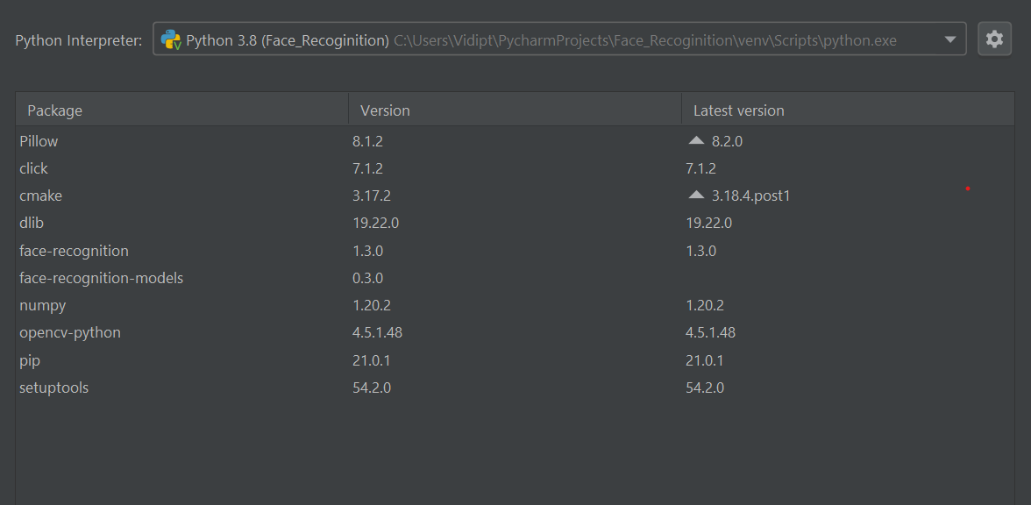
LIBRARY IMPORTED

Slide 10
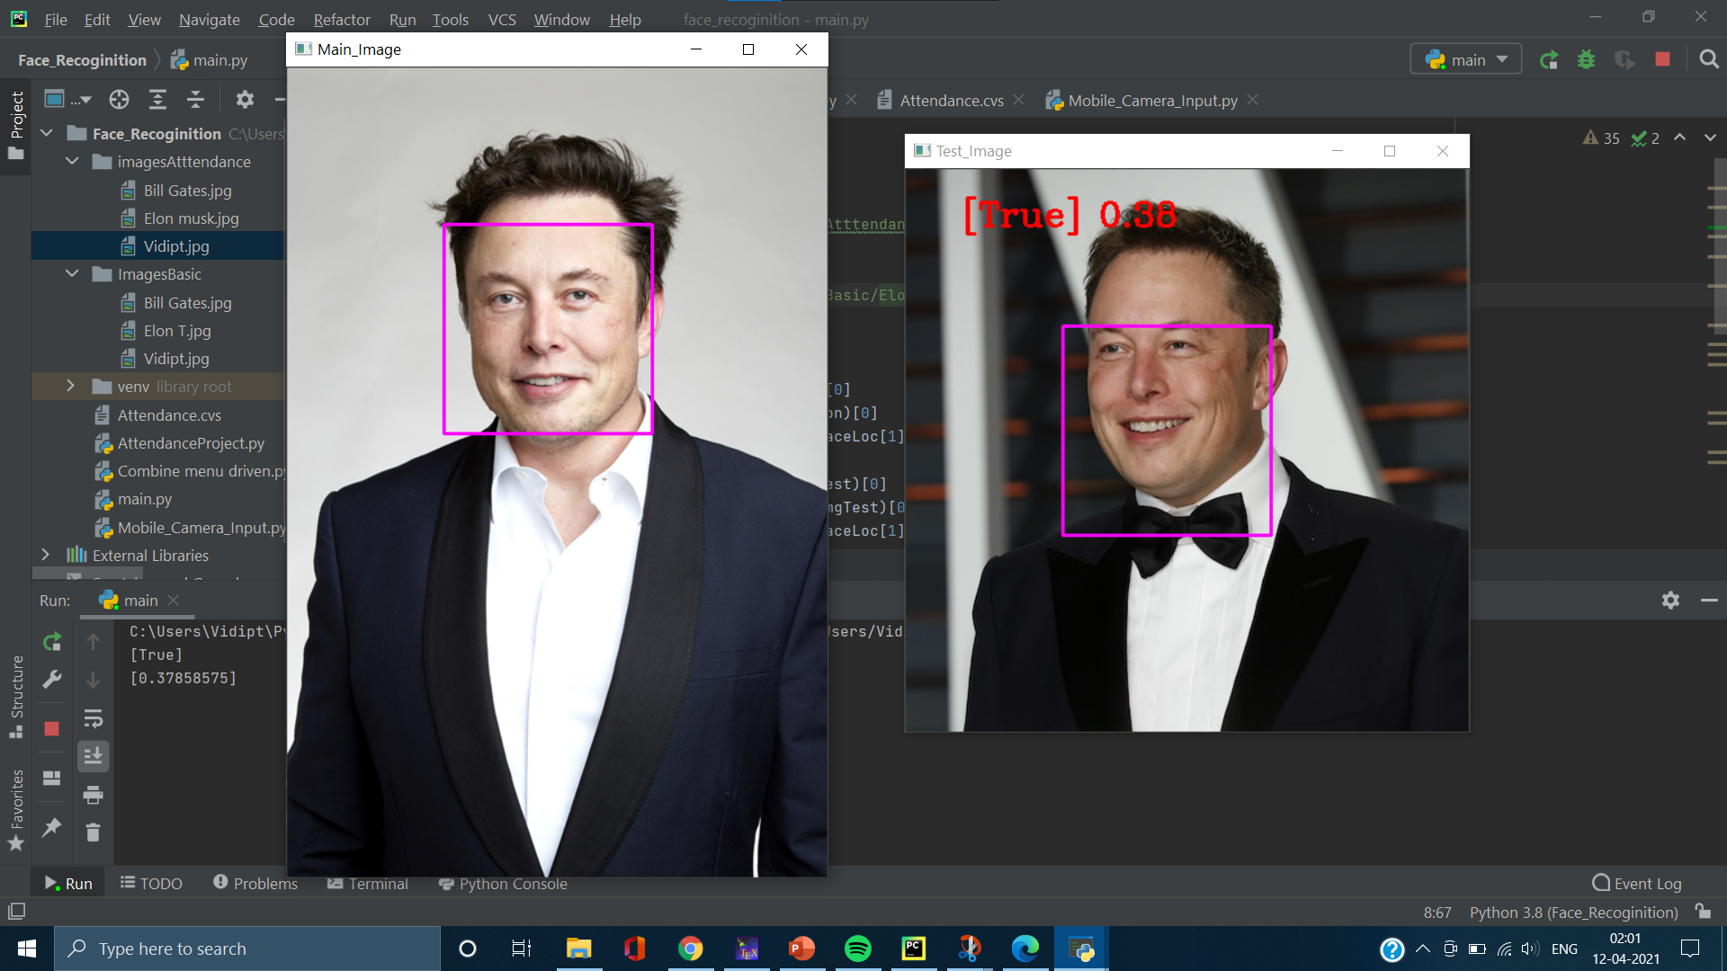
OUTPUT : INPUT FROM IMAGES

Slide 11
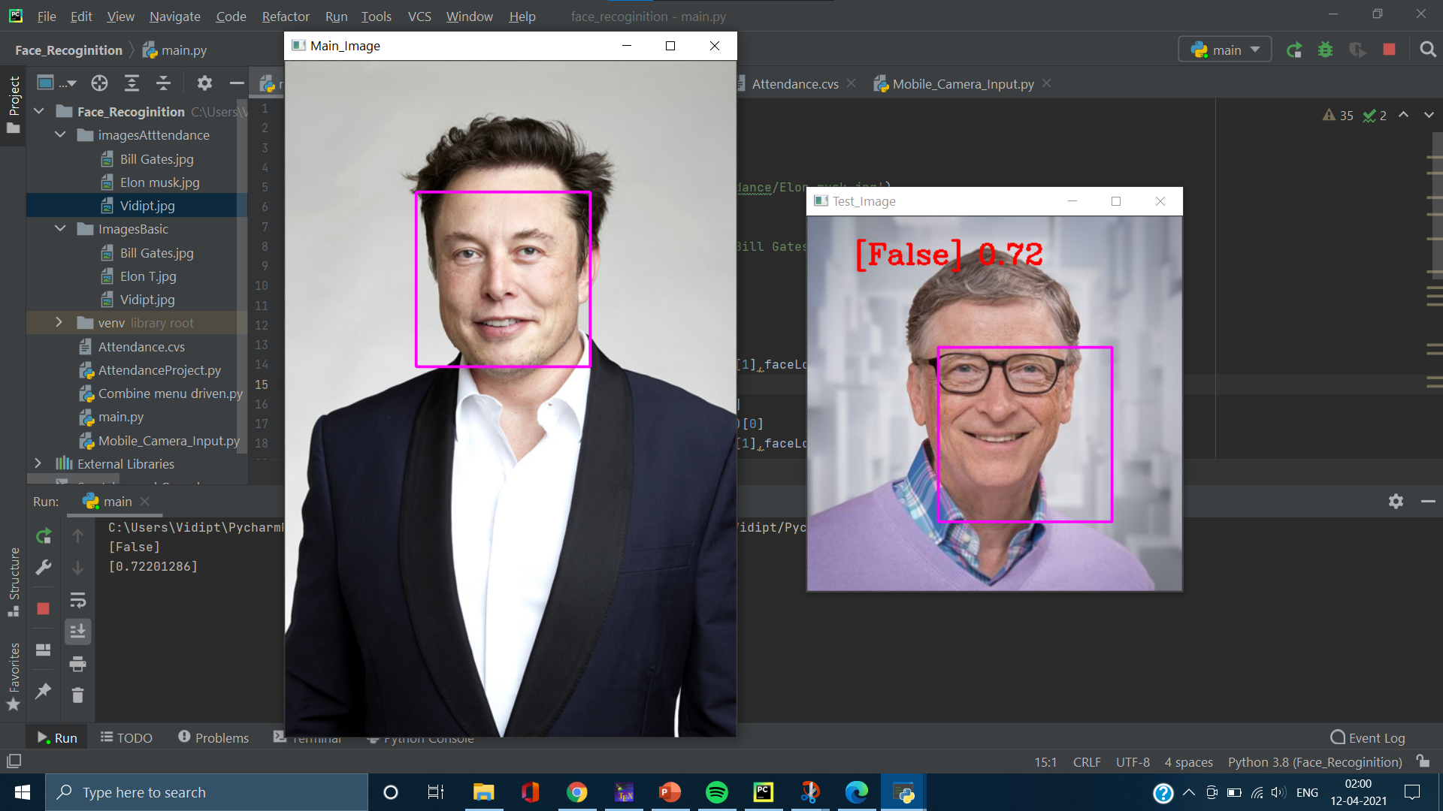
OUTPUT : INPUT FROM IMAGES

Slide 12
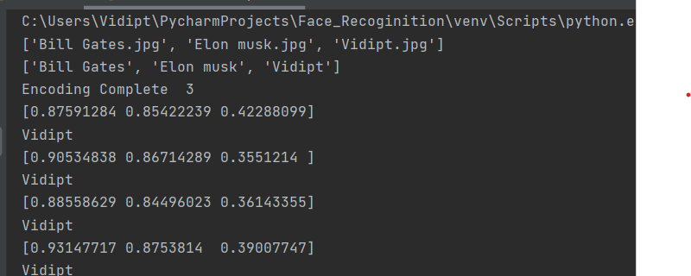
OUTPUT : ATTENDNACE PROJECT

Slide 13
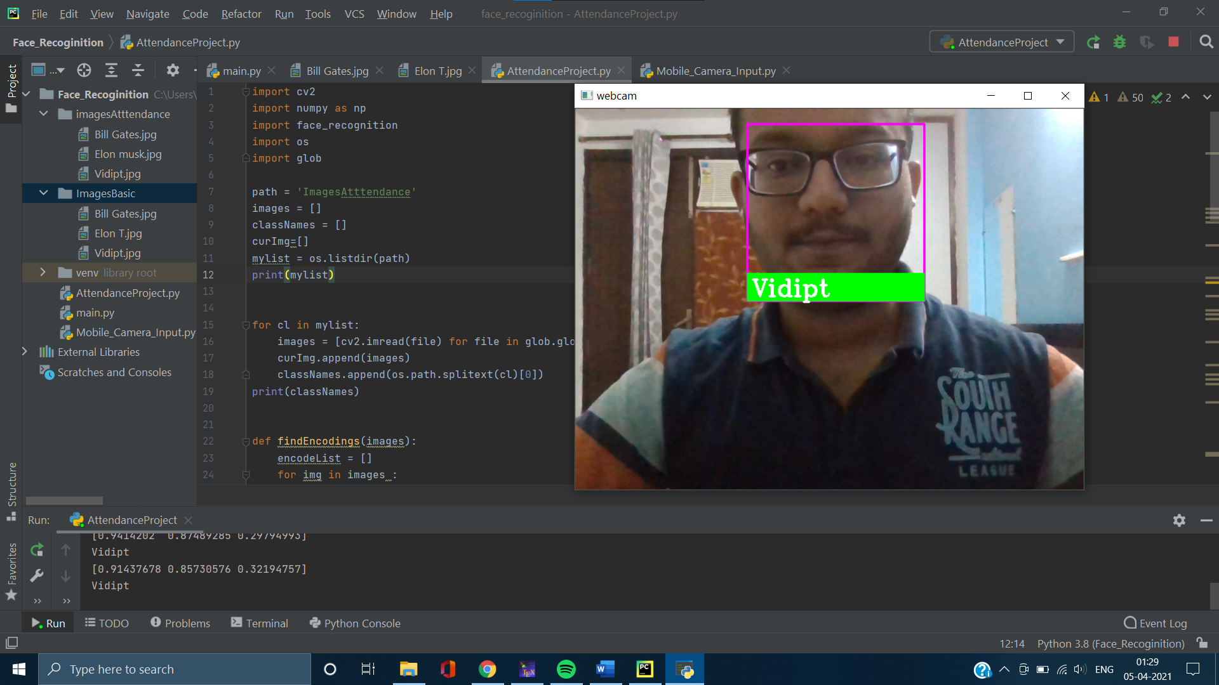
OUTPUT : ATTENDNACE PROJECT

Slide 14
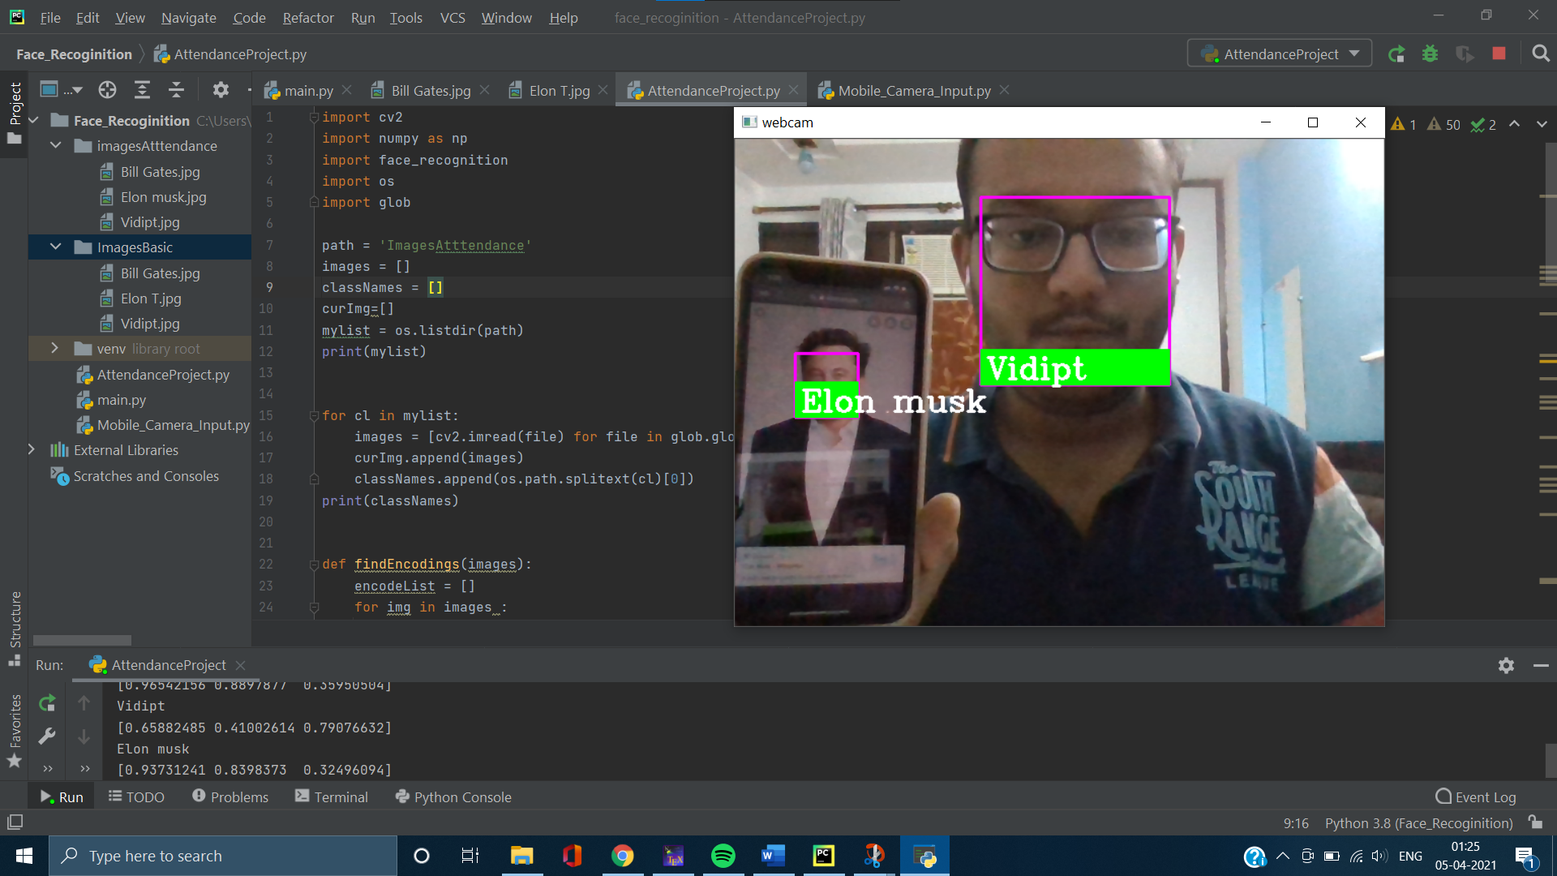
OUTPUT : ATTENDNACE PROJECT

Slide 15
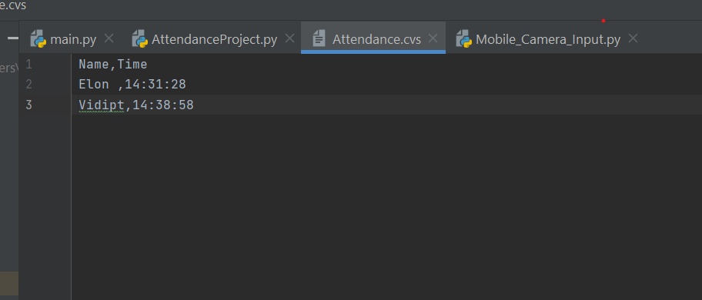
OUTPUT : ATTENDNACE PROJECT

Slide 16

OUTPUT : ATTENDNACE PROJECT

Slide 17
CONCLUSION
This paper describes the mini-project for Face Recognition using opencv in python .
Also, We have explains the library used in the project and the methodology used.
Real time video speed was satisfactory as well has a bit of noticeable frame lag. Considering that opencv can be implemented as a cost effective face recognition platform.
An example is a system to identify known people for Automatic Attendance.

Slide 18
REFERNCES
Takeo Kanade. Computer recognition of human faces, volume 47. Birkh¨auser Basel, 1977
Machine Learning is Fun! Part 4: Modern Face Recognition with Deep Learning | by Adam Geitgey | Medium
OpenCV – OpenCV

